Slide 1
OCaml: Variants and Recursive Types
CMSC 330: Programming Languages

Slide 2
Review OCaml Types
Primitive Type
bool, char, int, float, string
Product Type
tuple
Recursive Algebraic Type
‘a list
Notes:
What is missing? Sum types

Slide 3
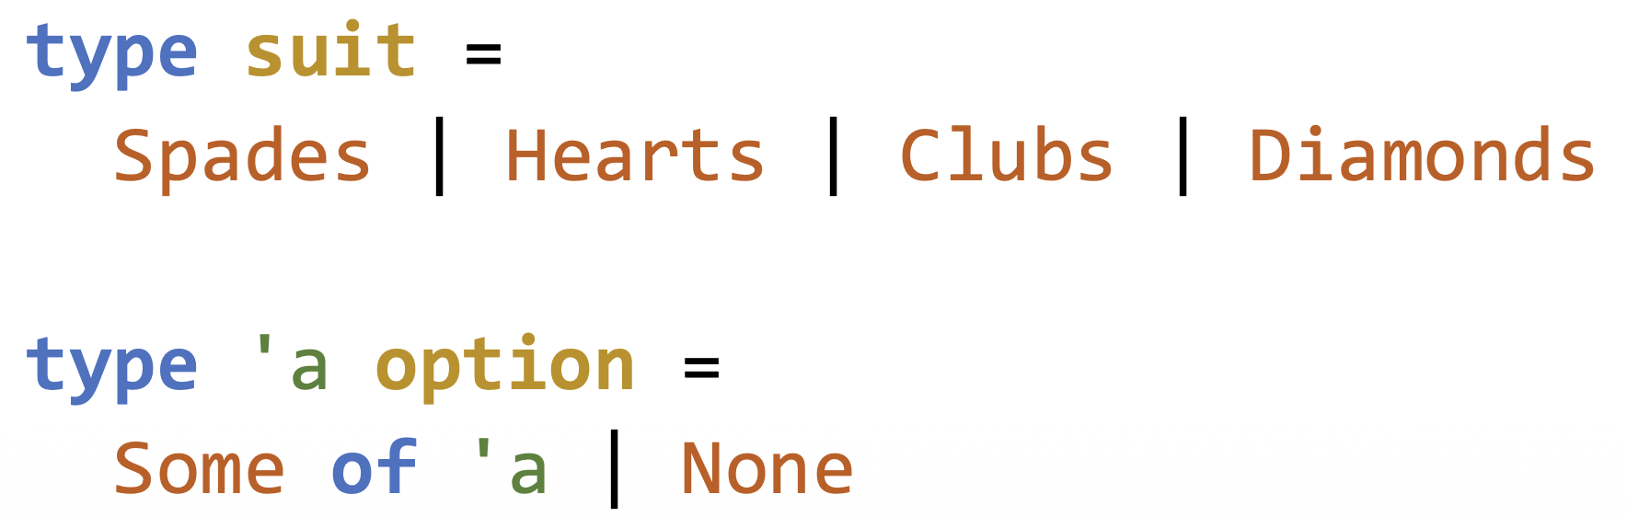
Variants
Also known as discriminated unions
Must provide a name tag for each option
Only ONE option can be active at any time
E.g.,

Slide 4
Variant Behavior
type suit =
Spades | Hearts | Clubs | Diamonds
The type suit can ONLY hold one of the four values (each value’s type is suit)
The tag or discriminator, is called a constructor in OCaml, which tells OCaml what choice to select
The constructor must start with a capital letter

Slide 5
Variant Behavior
type int_option =
Some of int | None
int_option is a predefined type
Some and None are its constructors
of int means the constructor Some takes an int argument
The type of Some: int -> int_option
Notes:
Some is a function
You can view None as unit -> int_option, but OCaml just simply treats it as int_option
Use of int_option? NaN can be None. If we just use int, we must find hacks like -99999 but it is not ideal

Slide 6
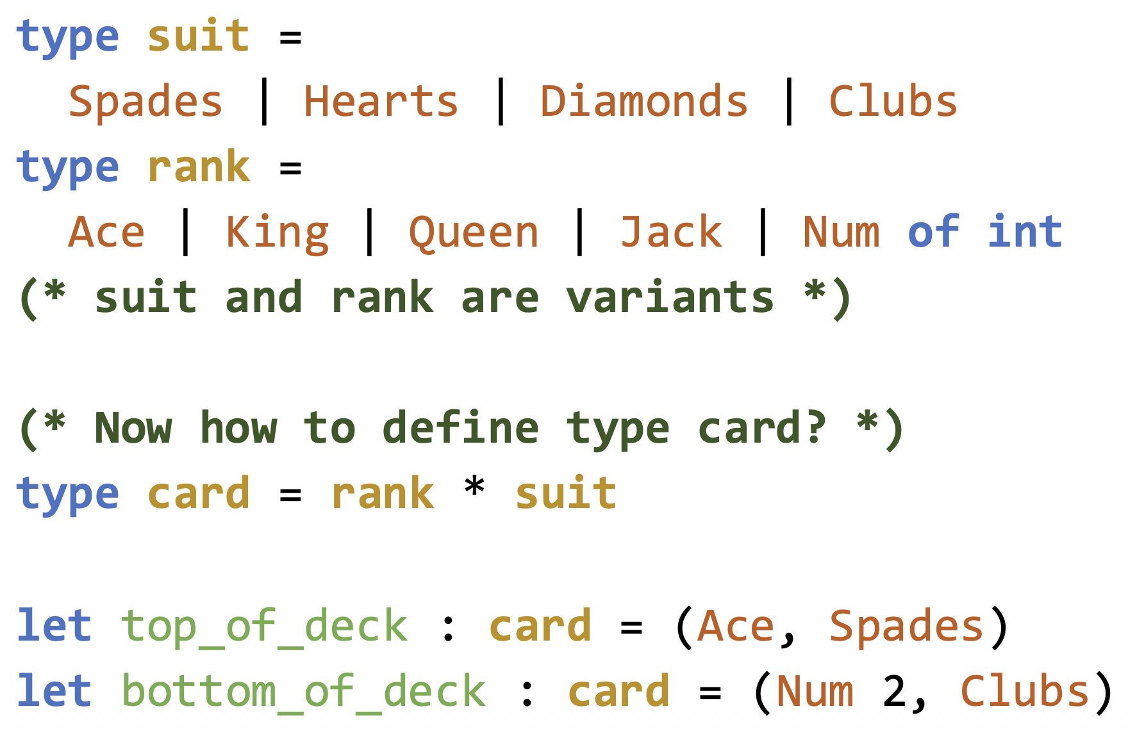
Variant Example
Notes:
What is the type of Num?

Slide 7
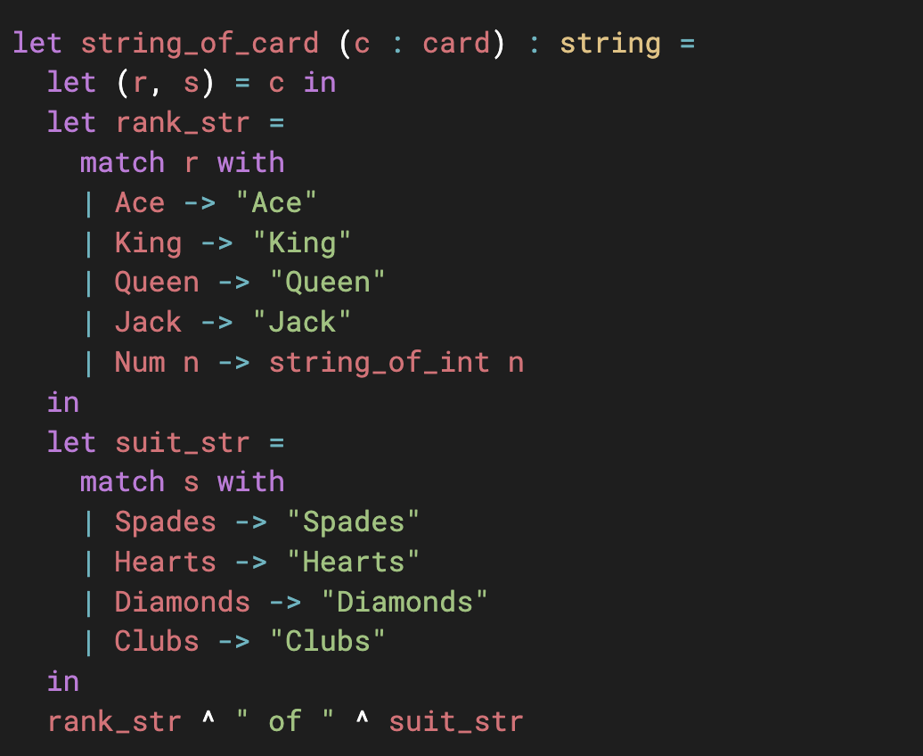
Variant Example
How to inspect a variant? Pattern Matching

Slide 8
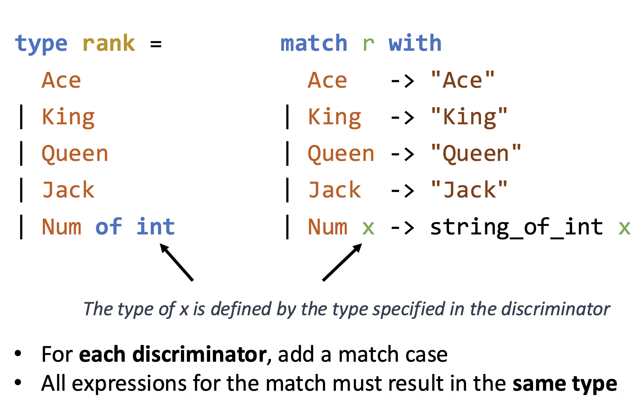
Variant Example
Notes:
Add a match case to each discriminator. Otherwise, legal but compiler gives warning

Slide 9
Variant Exercise
In OCaml, lists are homogenous
What if I want a list of elements of different types
Define a box type that can hold: int, float, bool, and string
Then you can create a box list
Write a function string_of that maps each box element to a string
Notes:
Think string_of_int: int -> string
String_of_bool: bool -> string

Slide 10
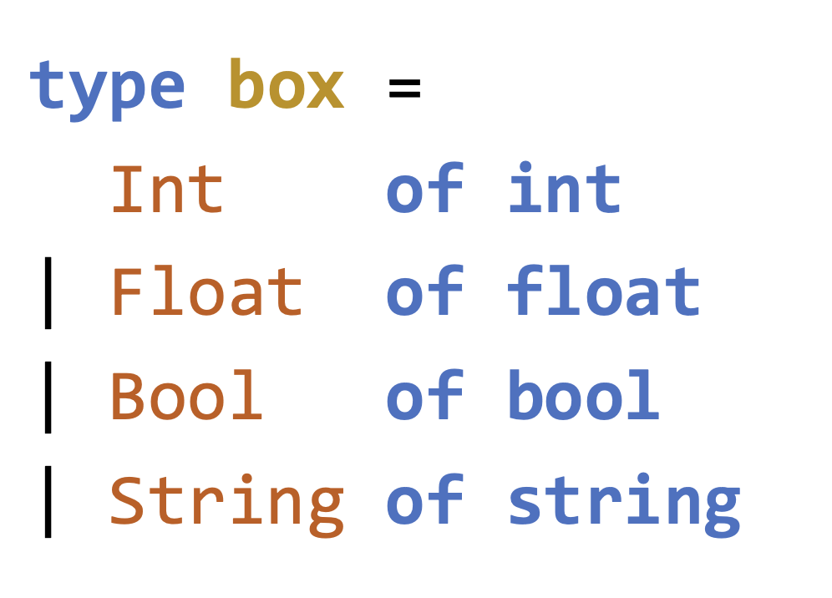
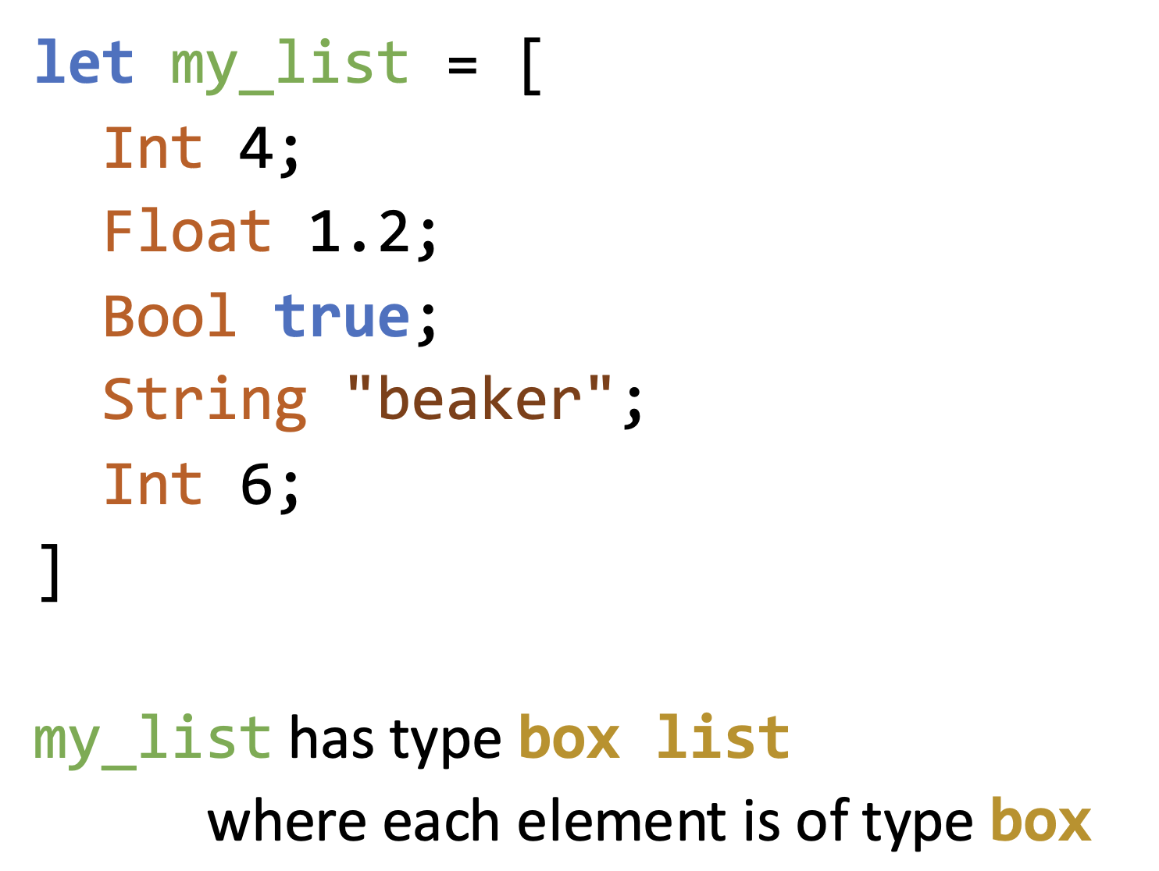
Variant Exercise

Slide 11
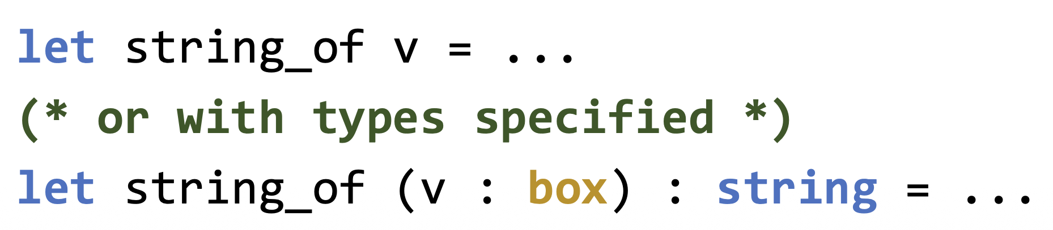
Variant Exercise
Write a string_of function which accepts a box value and returns the string representation

Slide 12
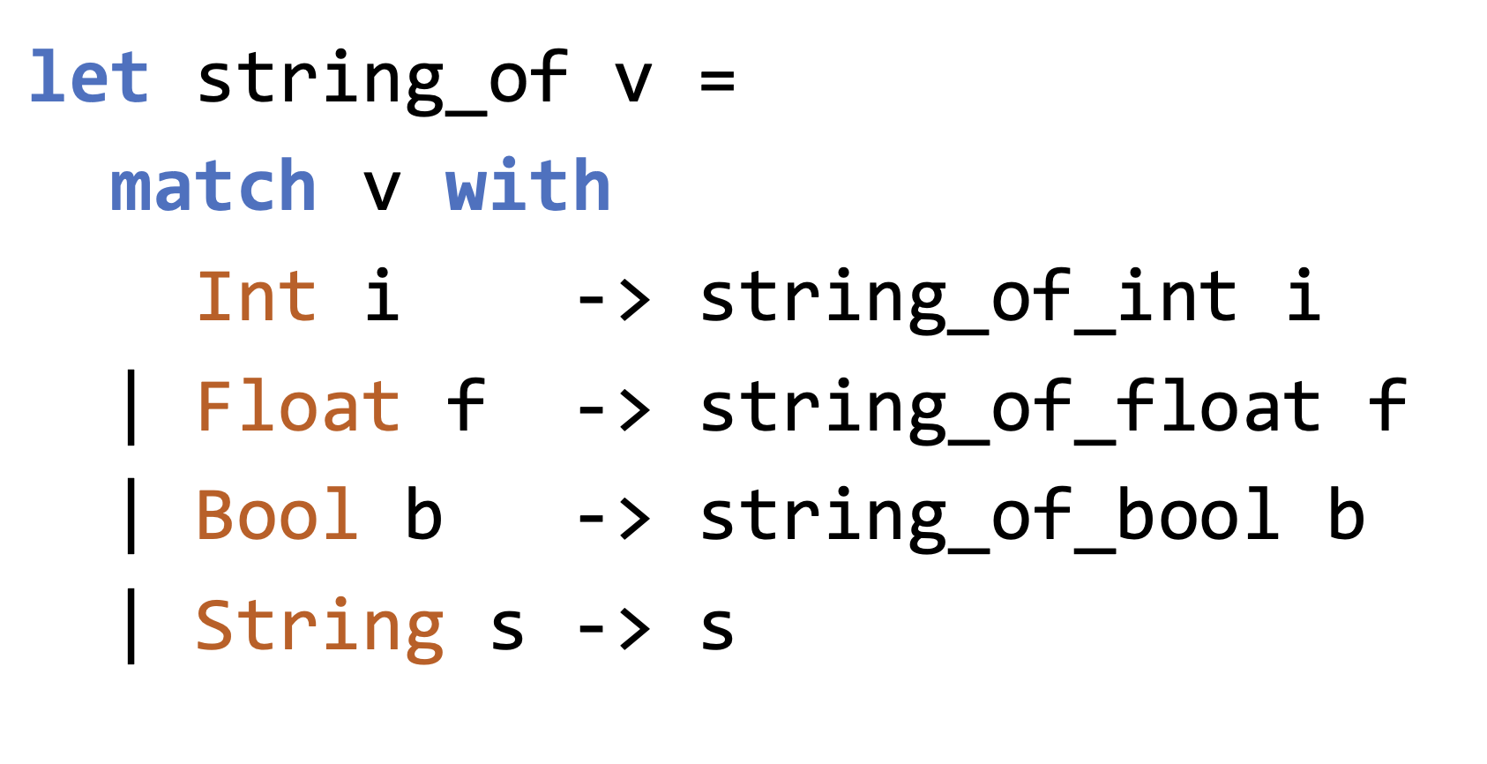
Variant Exercise

Slide 13
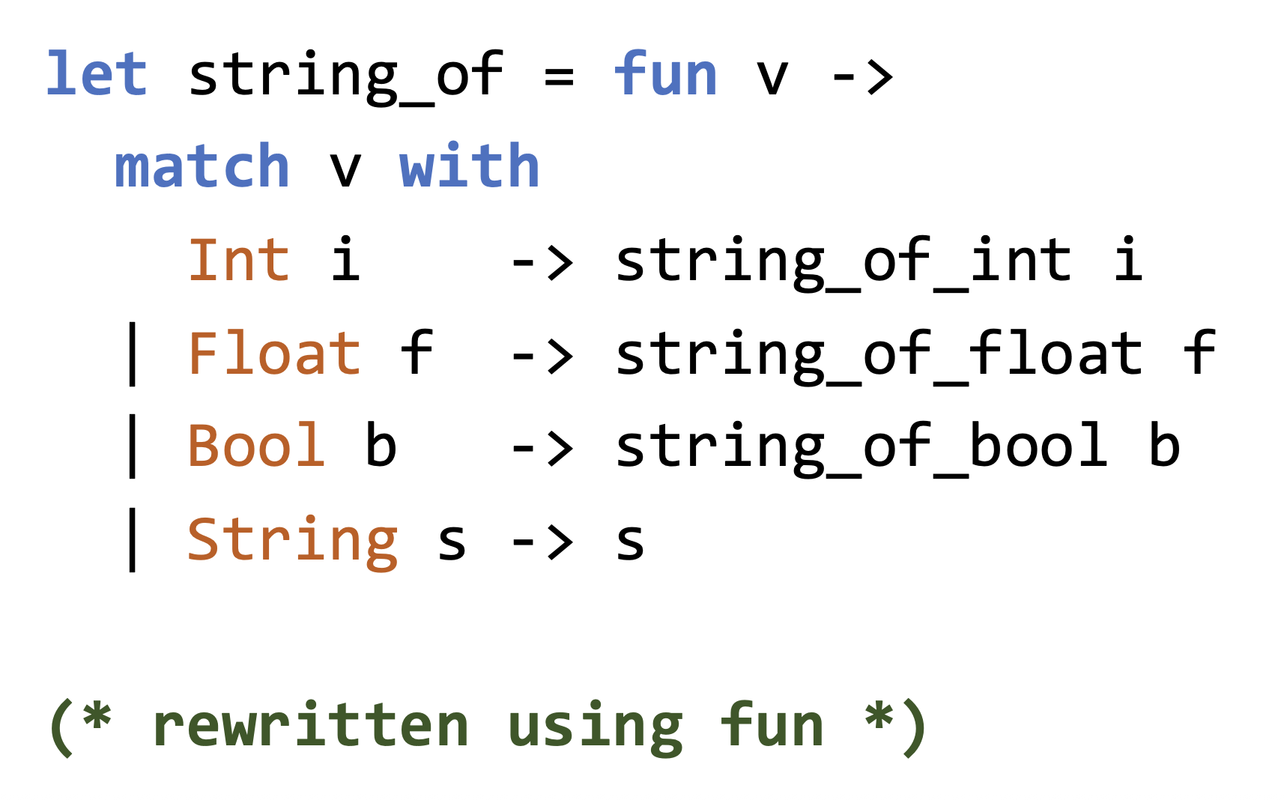
Variant Exercise

Slide 14
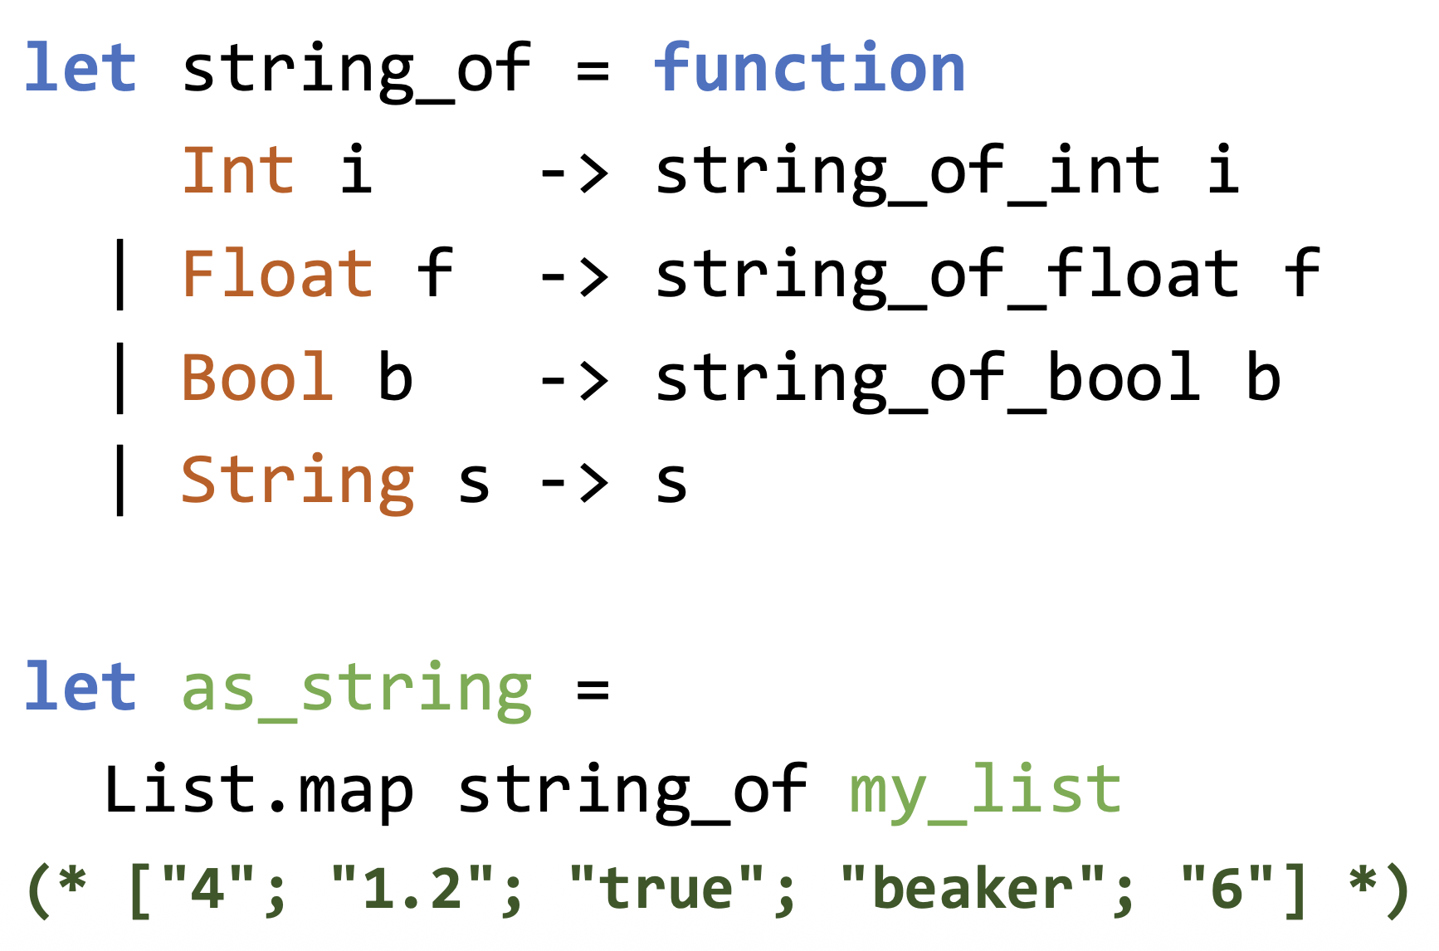
Matching Functions
The code pattern of
fun v -> match v with
is so common, there is syntactic sugar for it
function

Slide 15
Recursive Types
A type is recursive if its definition refers to itself
In OCaml, recursive types are commonly expressed using variant constructors or records that contain the type itself
type t = N | S of t
Show some values of type t
Any types you learned from other courses are recursive?
Notes:
Node

Slide 16
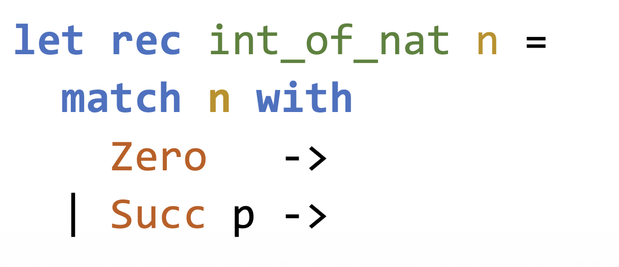
Natural Numbers
We can use the following type to model all natural numbers
type nat = Zero | Succ of nat
How to represent 0, 1, 2, …
Try:
Notes:
Convert nat to int
Then try convert int to nat let rec nat_of_int i =
if i = 0 then …
Else …

Slide 17
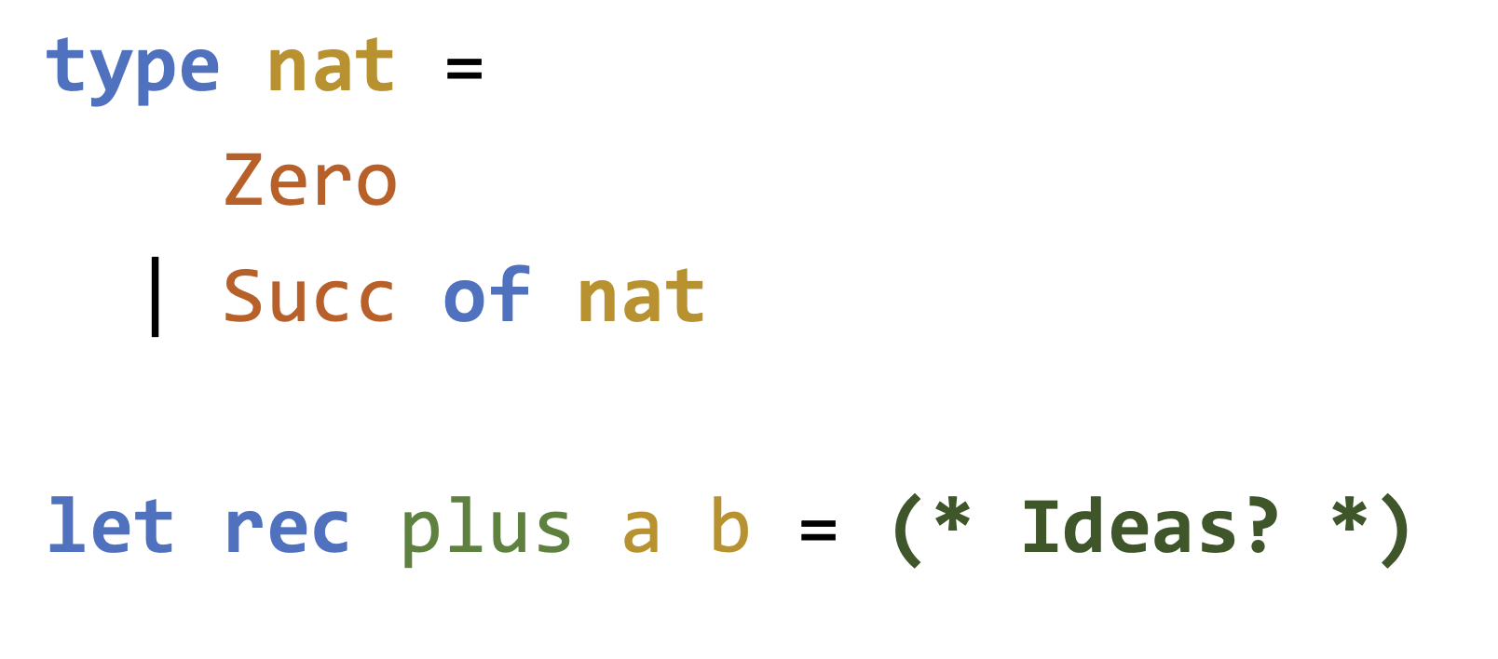
Natural Number Addition
Notes:
let rec plus a b =
match a with
| Zero -> b
| Succ a' -> Succ (plus a' b)

Slide 18
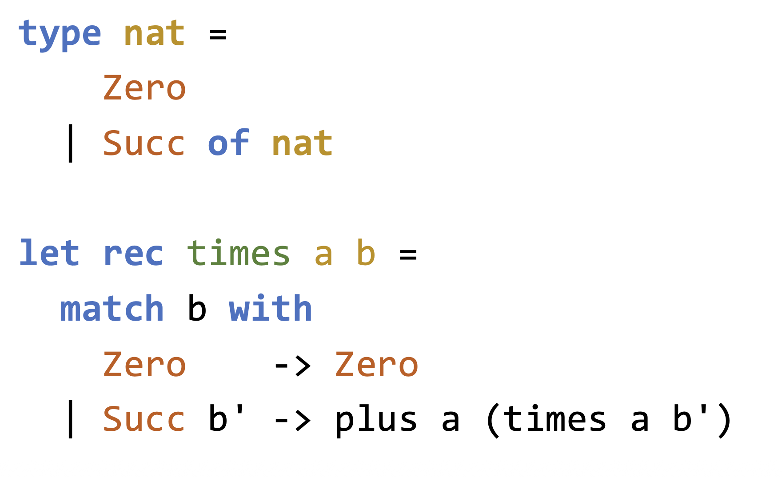
Natural Number Multiplication

Slide 19
(Our) Lists
OCaml lists are recursive
We can create our own list type:
type 'a lst =
Nil | Cons of 'a * 'a lst
[] corresponds to Nil
hd::tl corresponds to Cons(hd, tl)

Slide 20
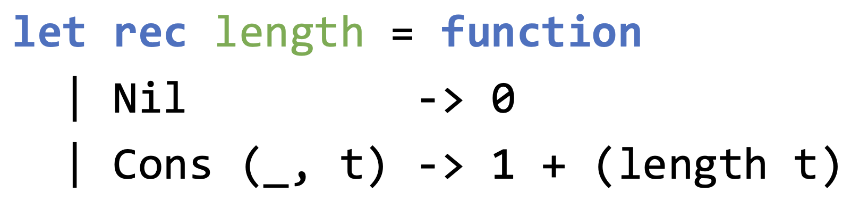
(Our) Lists
Write a function to return the length of a list (our type)

Slide 21
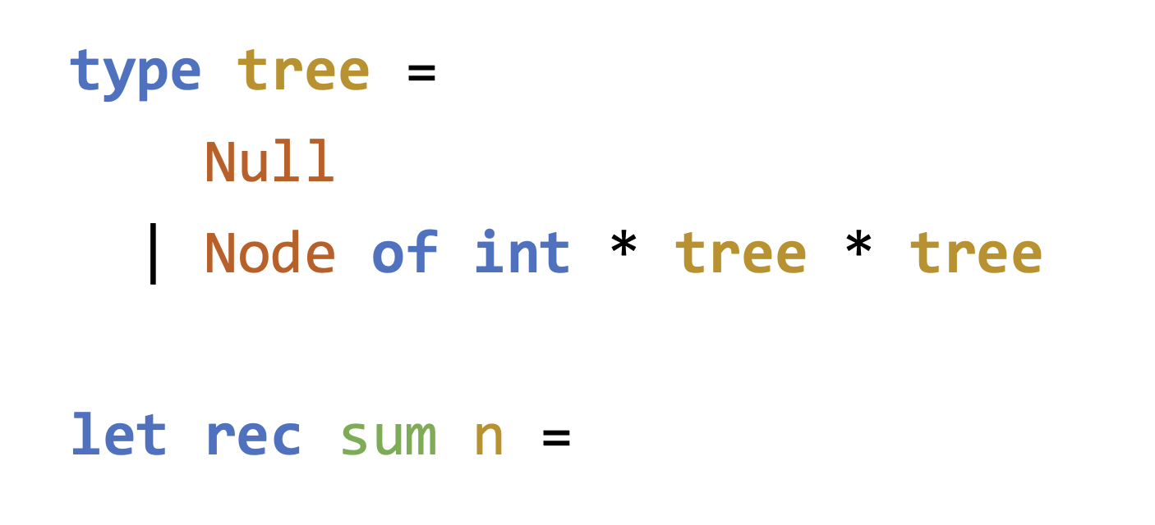
Trees
How can we represent an int binary tree?
Write a function to sum all nodes of a tree
Notes:
let rec sum t =
match t with
| Null -> 0
| Node (v, left, right) ->
v + sum left + sum right

Slide 22
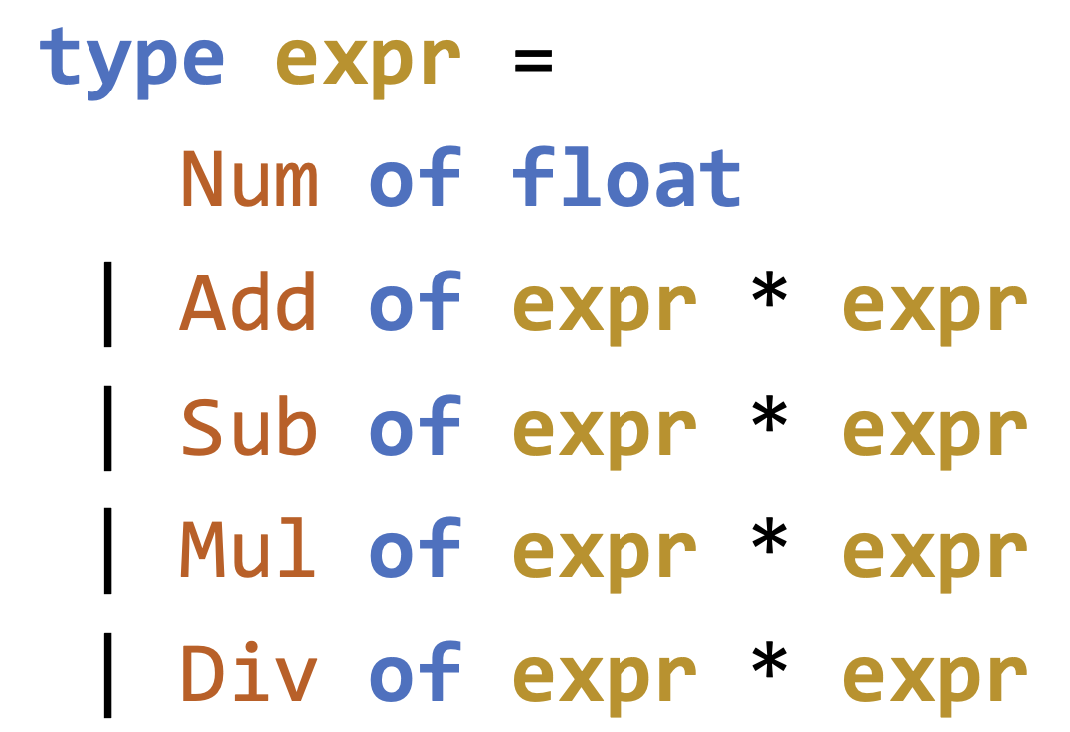
Expressions
We can represent expressions and evaluate them
4.0 + 3.9 ==> 7.9
512 - 82 ==> 430
(4.0 + 3.9) * (512 - 82) - 1372 ==> 2025
What type should we use for each expression?
Notes:
let rec last lst =
match lst with
| [] -> failwith "Empty list has no last element"
| [x] -> x (* only one element → return it *)
| _ :: xs -> last xs (* otherwise, recurse on the tail *)

Slide 23
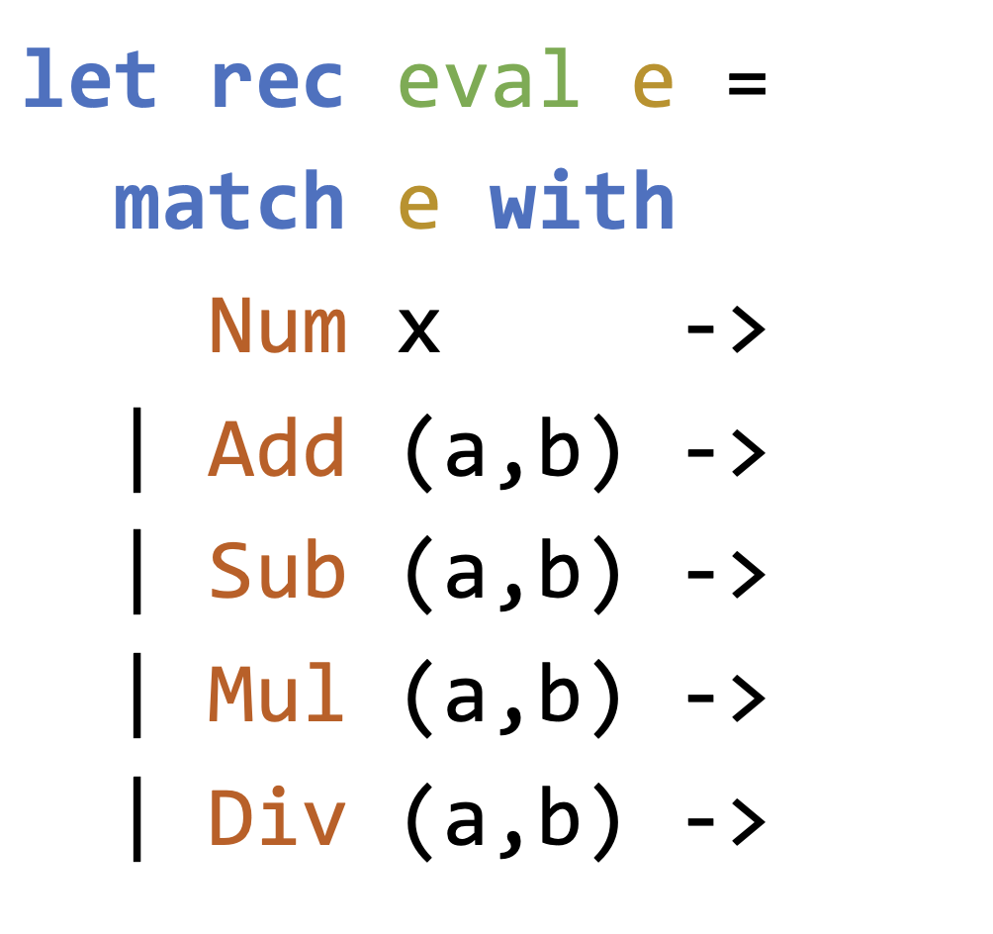
Evaluating Expressions
Notes:
let rec eval e = match e with | Num x -> x | Add (a, b) -> eval a +. eval b | Sub (a, b) -> eval a -. eval b | Mul (a, b) -> eval a *. eval b | Div (a, b) -> eval a /. eval b

